Slide 1
Group : Discover Decipher
Prediction of CO2 emission from vehicles using Machine Learning Algorithms
Nimisha Patel - AU1940146
Sakshi Shah - AU1940213
Astha Patel - AU1940312
Kareena Matwani - AU1940314

Slide 2
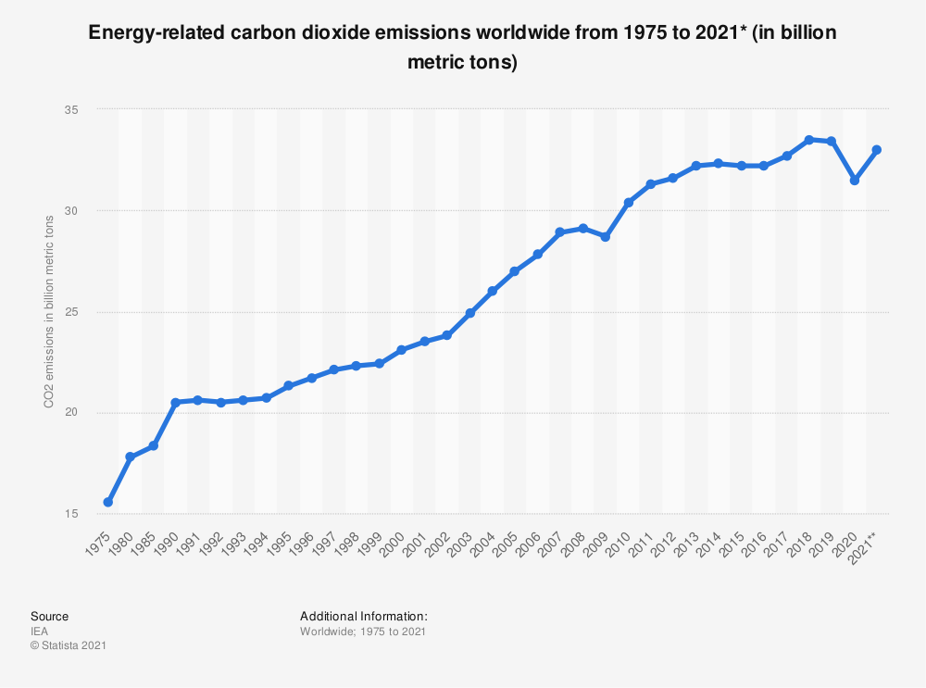
Introduction
Current Global CO2 Emission rates are bizzare due to increased reliance on fossil fuels leading to extreme overheating of the environment.
Major Influencing factors^{[1]}(IEA) :
- Electricity (29%)
- Transportation (24%) : Second Largest Source
- Industry
- Land Use (Agriculture)
Our aim is to accurately predict CO2 emissions and know the
most influencing variables for the CO2 emissions from vehicles.
Global CO2 Emissions from 1975 to 2021
Source : Statistica

Slide 3
Problem Statement
To predict CO2 emission based on vehicles using Machine Learning Models.
To accurately classify vehicles based on the variable into the following classes
The CO2 emission here is measured in g/km and the global standards
for the CO2 emission considered is 95g/km of CO2 for passenger
cars and for light commercial vehicles standards are 147 g/km of
CO2 and the classes are defined considering the global CO2 standards.
Emission <=100 g/km is considered low emission rate while >= 300
is not permissible , high emission rate of CO2^{[2].}(continental automobile)
Why Predict CO2 emission or classify vehicles based on the CO2 emissions ?
This will help classify vehicles into categories and in fixation of road tax and penalty as required to limit the emissions.
Used for green manufacturing that is sustainable, economically friendly and helps eliminate the risks associated with the environment by regulating CO2 emissions at each point of process.
Class 0 | <= 100 g/Km | Low Emission Range
Class 1 | 100 - 200 g/Km | Permissible Emission Range
Class 2 | 200-300 g/Km | Medium Emission Range
Class 3 | >=300 g/km | High Emission Range (Not permissible)

Slide 4
Existing Body of Work
The usage of GPR(Gaussian Process Regression) has been used as a part of research under the prediction of Co2 emissions with factors adding to Co2 are applied such as deforestation , pollution and their relation with the inputs and thus methods were applied, The other methods that were used for estimating Co2 emissions from electrical generation, the linear models and SVM were applied for predicting the LCOE(levelized cost of energy) value with different association algorithms.
The implementation of GPR has been done by the authors at China where they looked at statistical aspects where they found the application to be best fit to the model with the smallest of RMSE , MSE and MAE values^{[3]}. The other method used was applied on data available from iea(international energy agency) italy 2020 , ICER(Incremental cost effectiveness ratio) with the help SVM were calculated at the highest level of simplicity , the values RMSE , MAE and MAPE(Mean absolute percentage error) were found smallest which concludes the better performance of SVm in the given model^{[4]}.
The Model scope is very important in near future especially in our country (India) where there is a rise in usage of different types of hybrid and electric vehicles , this would help boost the implementing of different policies,road taxes and in green manufacturing according to different classified car models and prediction of emissions using ML models(non hybrid and non electric vehicles mostly).
Current Methods
Implementation
Future Scope

Slide 5
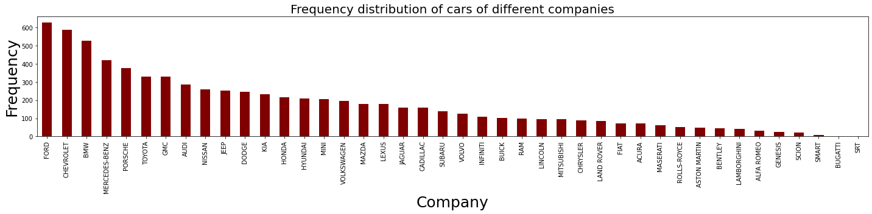
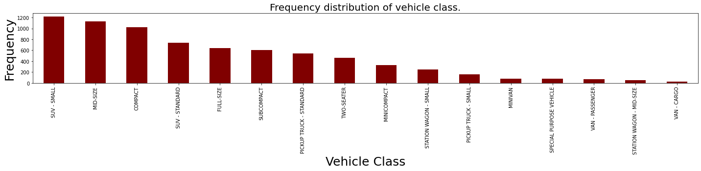
Dataset
Data Source : The CO2 emissions dataset was gathered from kaggle (csv file) which was publicly available and formulated with the help of the Canadian open Government official website ^{[5]}for the data. The dataset included 7385 rows [light duty vehicles] and 12 columns [features] which was observed for 2017-21 in Canada.
The Features present in the dataset are Vehicle Company, Model of the vehicle, Vehicle Class, Engine Size, Cylinders, Fuel Type, Fuel consumption city (L/100 Km), Fuel consumption Hwy (L/100 km), Fuel consumption Comb (L/100Km) (55% city and 45% highway), Fuel consumption Comb (mpg) (fuel efficiency measure).
The vehicles include different variety of light duty vehicles with different company and varied models. With the change in company, number of cylinders, engine size, fuel consumption, vehicle class and fuel type that is used also varies , which are the major features in CO2 emission Prediction.
Frequency Distribution of the vehicle company and vehicle class : used to analyse the data and know the distribution of the data
Notes:
For reference

Slide 6
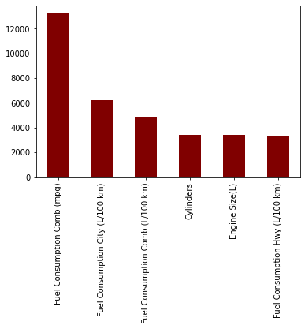
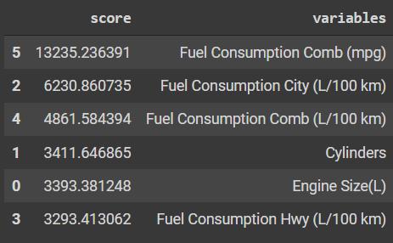
Approach
Data Cleaning : fixed the null values, typos, outliers and removed 1103 duplicate values. (5991 unique data), reindexing and re-formatting columns.
Exploratory Data Analysis - Found correlation between CO2 emissions with all the features measure the dependency using scatter plots, correlation coefficient and distribution plots.
Feature Selection - Chi square test to select highly dependent features. Found Fuel consumption in city & Combination, cylinders and engine size to be highly responsible for CO2 emissions.
Test Train splitting - 80% train dataset and 20% test dataset.
Implementation using google collaboratory :
Group7_Discover Decipher_Mid_Sem_ProjectImplementation.ipynb
Chi2 score for input features for feature selection

Slide 7
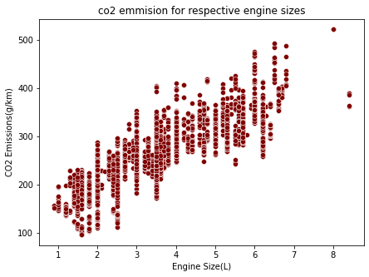
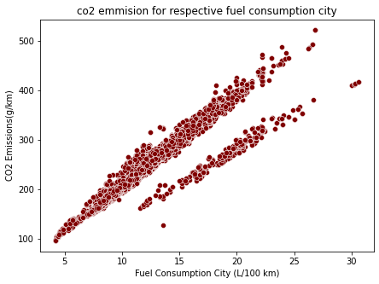
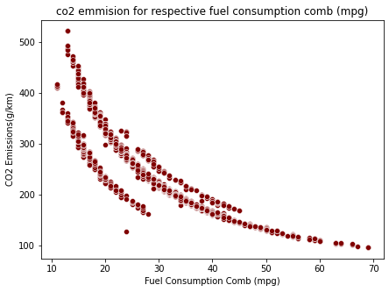
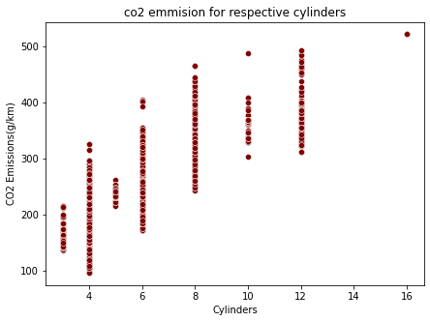
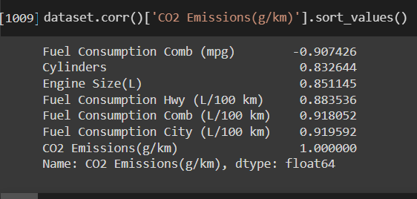
Exploratory Data analysis
Univariate analysis : Plotting frequency distribution, box-plot and histogram.
Multivariate Analysis : Compared the two variables, one CO2 emission and other varied features like engine size, fuel consumption city, fuel consumption comb and cylinders.
These analysis helped determine correlation, dependency, distribution and outliers in the dataset.
Scatter plots shows strong positive correlation between CO2 emissions and Engine size (L), Fuel consumption in city and Cylinders, while strong negative correlation for fuel consumption Comb (mpg).
Correlation among feature variables used for feature selection

Slide 8
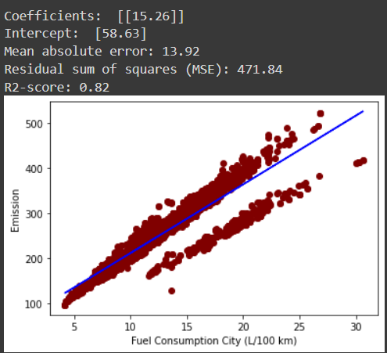
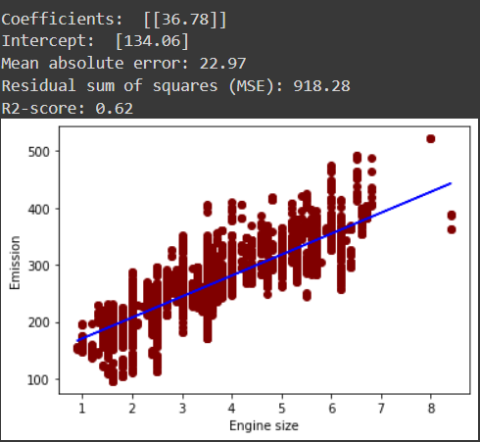
Approach
Fuel Consumption Comb (L/100 Km) Mean absolute error: 13.54 Residual sum of squares (MSE): 473.81 R2-score: 0.82
Fuel Consumption City (L/100 Km) Mean absolute error: 13.92 Residual sum of squares (MSE): 471.84 R2-score: 0.82
Cylinders Mean absolute error: 23.91 Residual sum of squares (MSE): 1015.51 R2-score: 0.58
Engine Size (L) Mean absolute error: 22.97 Residual sum of squares (MSE): 918.28 R2-score: 0.62
Fuel Consumption Hwy (L/100 Km) Mean absolute error: 17.47 Residual sum of squares (MSE): 678.59 R2-score: 0.73
Linear Regression : Most basic form of regression analysis and has simple approach and helped determined the dependency more accurately for different features.
Single variable Linear Regression on the high chi2 scored features
Better R2 score better the linear fit for the dependent variable

Slide 9
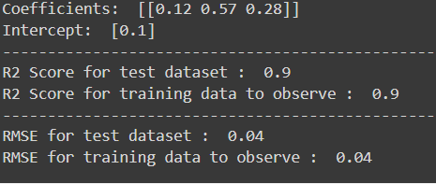
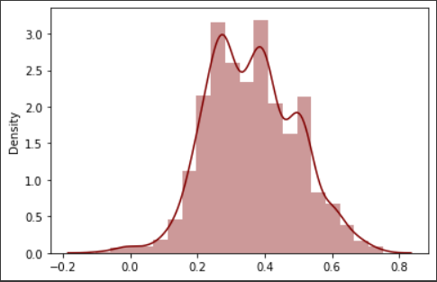
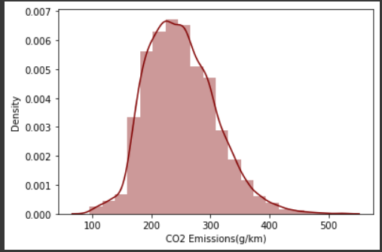
Approach
Multivariable Regression : There are various other variables that influences CO2 emission, therefore we used multiple regression for better accuracy and to find the best fit by measuring the degree at which several independent variables and are linearly related to CO2 emissions rate. The features for multivariable regression were selected using Chi2 test.
Multivariable Linear regression
Difference in test set
predictions
Difference in train set
Predictions
Variables : Fuel Consumption Comb (L/100 Km), Fuel Consumption City (L/100 Km), Cylinders, Engine Size (L), Fuel Consumption Hwy (L/100 Km)
Other example implemented : Multivariate linear model
Engine Size(L), Fuel Consumption Hwy (L/100 km), Cylinders, CO2 Emissions(g/km)
R2 Score for test dataset : 0.86
RMSE for test dataset : 0.051

Slide 10
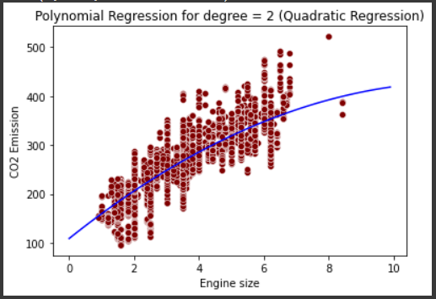
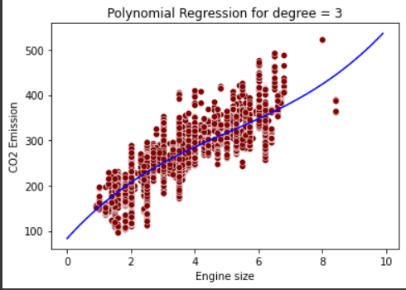
Approach
Polynomial Regression : Linear regression fails to determine the
best fit and it becomes difficult to select the best model in
multivariable regression with an considerable accuracy.
Therefore we used polynomial regression to overcome
this problem. Plotted for degree 2 and 3.
The accuracy of the model decreases with the increase in degree because of the increase in error rate, The scatter plot for variable feature engine size (L) shows linear strong positive correlation with the dependent variable CO2 emissions and thus, with the increasing degree of polynomial, error rate seems to be increased.
Decision Tree Regression (started) : It is necessary to obtain a real value of CO2 emission that is accurate enough and thus we started with decision tree regression. Decision Tree regression also works well for high dimensional data and evaluates all possible traces and outcomes. Mean Squared Error : 0.15 and R2 score 0.95.
Degree 2
R2 Score(test): 0.63
MSE: 902.34
Degree 3
R2 Score(test): 0.62
MSE: 925.76

Slide 11
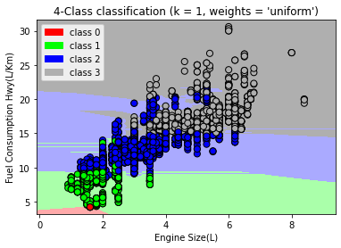

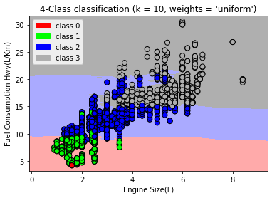
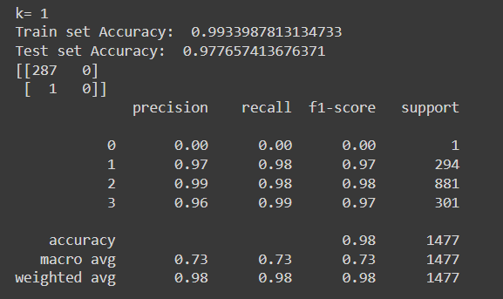
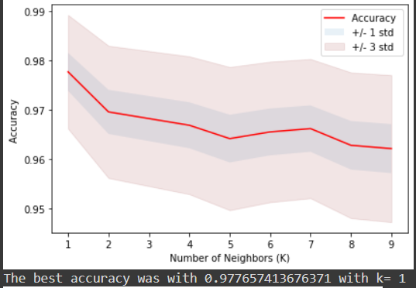
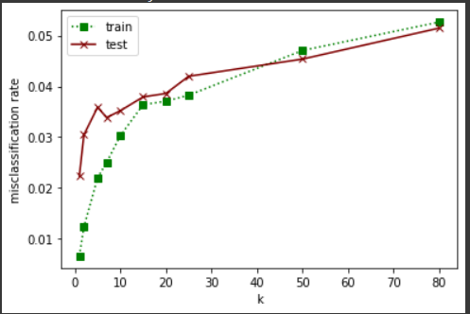
k=1 plot
Underfitting cases observed for K=5 and K=10
KNN : As mentioned, classifying is also necessary. Plottin the correlation clusters we decided to use KNN classifier for the 4 class classification.
Confusion matrix
Confusion Matrix is used to determine the performance of the classifier function, here most of the values are true negatives, that is correct classification of negatives. Also the accuracy score, recall and f1 score that are class level and general performance measuring matrices are >0.95 which means that the model has good accuracy in 4 class classification.
Accuracy vs K
K = 1 , maximum accuracy 98%
Error rate vs K
K = 1 , minimum test error
Notes:
k= 2
Train set Accuracy: 0.9845971563981043
Test set Accuracy: 0.96614759647935
k= 5
Train set Accuracy: 0.9793500338524035
Test set Accuracy: 0.967501692620176
k= 10
Train set Accuracy: 0.9712254570074476
Test set Accuracy: 0.9647935003385241
Decision regression
Mean Squared Error 0.14660663388066333
R2 Score 0.9470003270239792
Accuracy of Logistic regression classifier on training set: 0.91
Accuracy of Logistic regression classifier on test set: 0.91
Accuracy of Decision Tree classifier on training set: 0.99
Accuracy of Decision Tree classifier on test set: 0.98
Accuracy of K-NN classifier on training set: 0.98
Accuracy of K-NN classifier on test set: 0.97
Accuracy of GNB classifier on training set: 0.84
Accuracy of GNB classifier on test set: 0.84
Accuracy of LDA classifier on training set: 0.88
Accuracy of LDA classifier on test set: 0.88
Accuracy of SVM classifier on training set: 0.96
Accuracy of SVM classifier on test set: 0.95

Slide 12
Degree 2 Accuracy : 63% R2 score : 0.63 MSE : 902.34 | Degree 3 Accuracy : 62% R2 score : 0.62 MSE : 925.76
R2 score : 0.903
RMSE : 0.042
Accuracy : 98%
K=1
Polynomial Regression
Single variable Linear Regression
Multivariable linear regression
Decision tree Regression
KNN
Fuel Consumption City Accuracy : 82% R2 score : 0.82 MSE : 471.84 | Engine Size Accuracy : 62% R2 score : 0.62 MSE : 918.28
Accuracy : 95%
Mean square error :0.15

Slide 13
Role of each group member
Nimisha Patel
Sakshi Shah
Astha Patel
Kareena Matwani
Research.
General analysis for report.
Some part of Implementation.
Research.
General analysis for report.
Some part of Implementation
Research.
Implementation.
General analysis for report.
Research.
General analysis for report.
Some part of Implementation.

Slide 14
Future Work - Better accuracy , reliable, capturing uncertainties
Decision Tree method, RF and SVM
Regression model in depth
Handling multicategorical values
For better accuracy in terms of predicting real values as well as classification
Evaluates all possible outcomes and traces conclusion.
Can handle high dimension data as it does not require parameter setting or domain knowledge
Effectiveness in high dimension when all the multicategorical data can also be inculcated.
Feature analysis and selection, To determine the impact of each feature.
Know the most influencing feature in CO2 emission prediction.
Handling other categorical features having multiple categories like Make , Model
Vehicle class, Fuel type.
Assigning a particular value to each category because feature variables like fuel type are important in consideration of CO2 emissions ^{[1]}

Slide 15
References
Iea, “Tracking Transport 2020 – analysis,” IEA, 01-Jun-2020. [Online]. Available: https://www.iea.org/reports/tracking-transport-2020. [Accessed: 18-Mar-2022].
H. Ritchie and M. Roser, “Emissions by sector,” Our World in Data, 11-May-2020. [Online]. Available: https://ourworldindata.org/emissions-by-sector#:~:text=The%20global%20breakdown%20for%20CO,transport%2C%20and%20manufacturing%20and%20construction. [Accessed: 15-Mar-2022].
N. Ma, W. Y. Shum, T. Han, and F. Lai, “Can machine learning be applied to carbon emissions analysis: An application to the CO2 emissions analysis using gaussian process regression,” Frontiers, 01-Jan-1AD. [Online]. Available: https://www.frontiersin.org/articles/10.3389/fenrg.2021.756311/full. [Accessed: 25-Mar-2022].
M. Rao, “Machine learning in estimating CO2 Emissions from electricity generation,” IntechOpen, 12-Apr-2021. [Online]. Available: https://www.intechopen.com/online-first/76238. [Accessed: 27-Mar-2022].
“Fuel consumption ratings,” Open Government Portal. [Online]. Available: https://open.canada.ca/data/en/dataset/98f1a129-f628-4ce4-b24d-6f16bf24dd64#wb-auto-6. [Accessed: 27-Mar-2022].
“Towards the systematic reporting of the energy and carbon ...” [Online]. Available: https://jmlr.org/papers/volume21/20-312/20-312.pdf. [Accessed: 15-Mar-2022].

Slide 16
Thank You
Predicted CO2 Emission
Group : Discover Decipher

